Slide 1
dff
Recommendation System
By:
Kritnandan_220550

Slide 2


Recommendation System
A recommendation system, or recommender system, is an AI algorithm that uses data to suggest items to users based on their interests, preferences, and patterns. In the case of the movie recommendation system, it is a way to describe a process that tries to predict our preferred items based on our or people similar to us.

Slide 3

Types Of Recommendation
Content Based
Profile Based
Hybrid Based
A content-based recommendation system analyzes the content of items to make recommendations.
For example, in a movie recommendation system, if a user enjoys action movies with Tom Cruise, the system might recommend other action movies starring Tom Cruise.
Profile-based recommendation systems match users with similar profiles and suggest items liked by those similar users. It's like having a matchmaker who connects you with people who have similar tastes and recommends things they've enjoyed, anticipating that you might like them too.
A hybrid based recommendation system is a approach which combines the content based and collaborative filtering methods to suggest the items name to the users. in the movie recommendation combining their user preference to similar user’s ratings and recommended the movies

Slide 4



Slide 5

Different Genres Present In Dataset

Slide 6
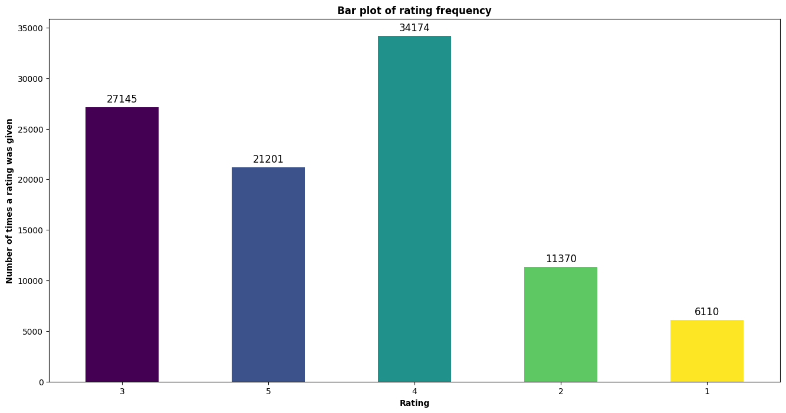
Frequency Of Ratings vs Ratings

Slide 7
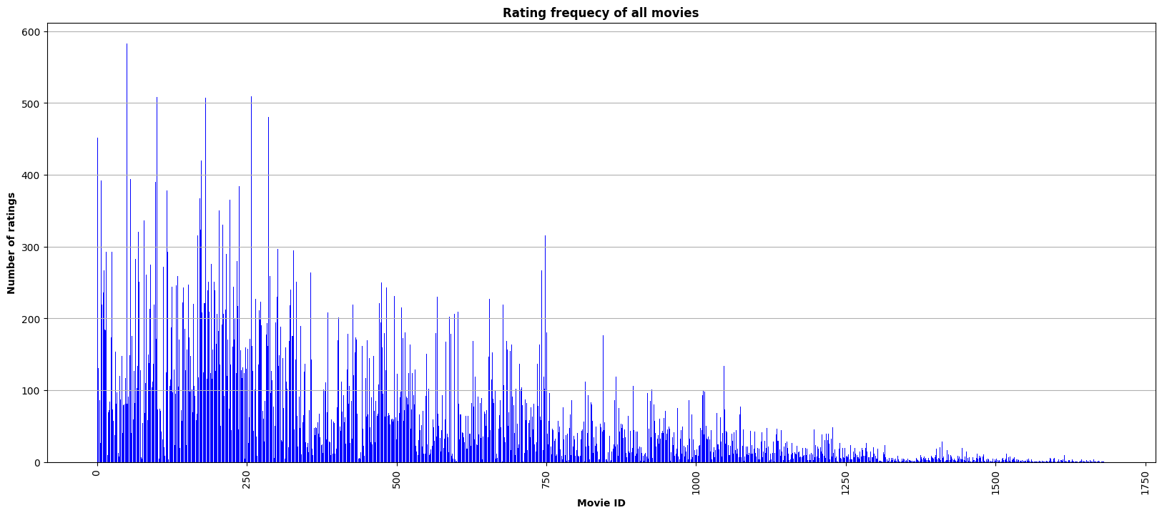

Slide 8
c
User Based Collaborative Recommendation
Definition:
KNN Algorithm
User-based collaborative filtering makes recommendations based on the user’s preferences that are similar to other users.
The K-Nearest Neighbors (KNN) algorithm is a machine learning technique used to determine the similarity between items or users based on a given similarity metric, such as cosine similarity.
On the basis of above algorithm recommended the movie
KNN recommends the k movies most similar in genre to the user input or search query. Finally, when a user inputs their movie preferences or searches for a specific movie, the KNN algorithm searches for the k- nearest neighbours and recommends them to the user.

Slide 9
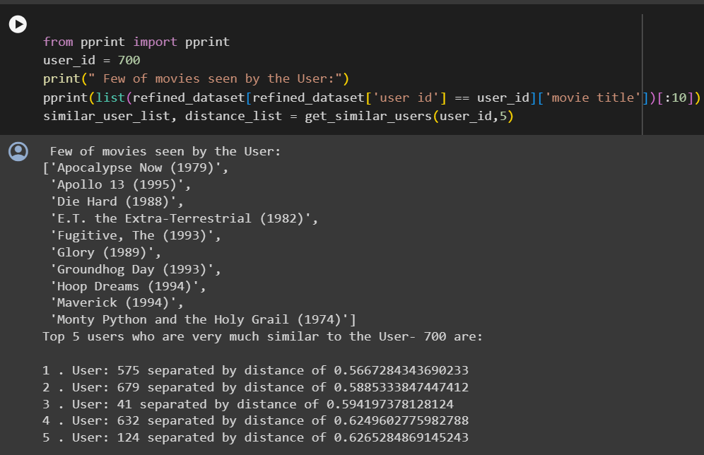
with the help of the KNN model we got the similar user to user number 700

Slide 10
c
User Based Collaborative Recommendation
How We are recommending the movie?
1)Taking the average of the existing ratings given by similar users and picking the top 5 or 10 movies to recommend to current users.
problem:
We have a group of friends who have similar tastes in movies to us. Some of these friends are closer to us in terms of similarity, meaning they have almost identical tastes, while others are a bit farther away, meaning they have some differences in preferences.
Solution:
Now, if we want to decide what movie to watch, we might trust the opinions of our close friends more because they're more like us. So, instead of just taking the average of all our friends' ratings, we might give more weight to the ratings of our closest friends. This means their opinions will have a bigger impact on our decision compared to those of your more distant friends.

Slide 11
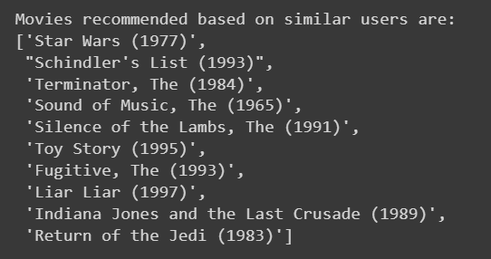
This recommendation system have some drawback it also recommend the same movie which are already seen by the user previously. And also a possibility of recommending that movie which are not seen by similar users.

Slide 12
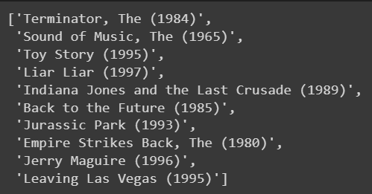
Final Recommendation for user id 700
For the solution of the previous problem define a function and remove that movie which is already seen by the those or none of similar users watched

Slide 13
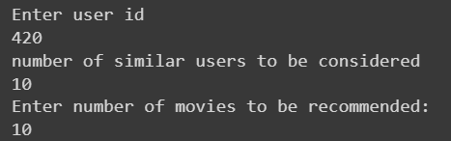
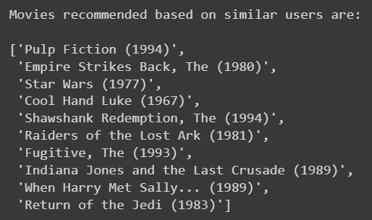
In the previous slide, we generated the recommendation for user ID 700 in the same way we created the function in which we can put any user ID, number of recommended movies and number of similar users so we get the recommended movie on the basis of current user id

Slide 14

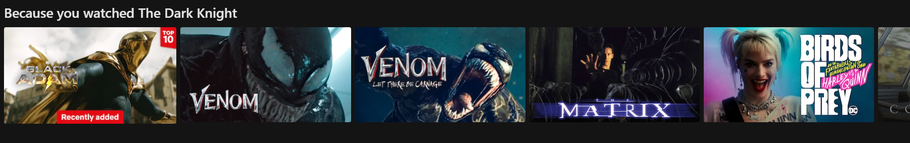
c
Item Based Recommendation

Slide 15
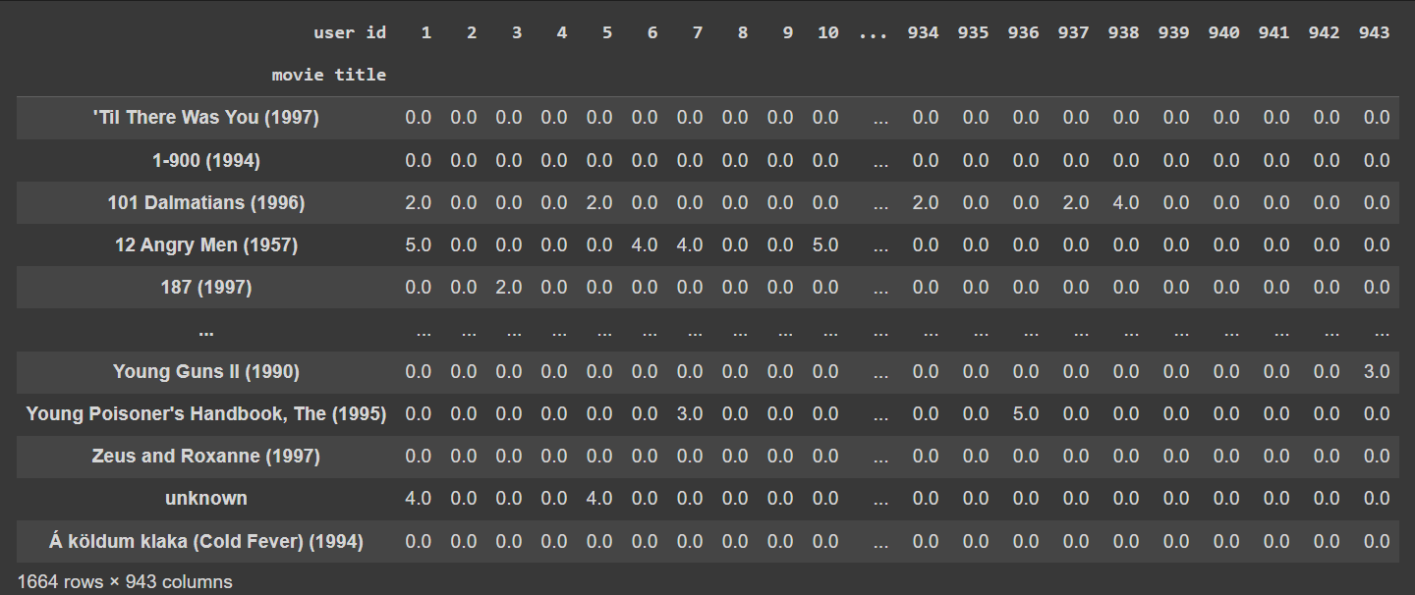
We have trained KNN model to discover closely related movies based on the input movie. Using this model, we recommended the top movies that closely match the given one, ensuring better alignment with the user's preferences

Slide 16
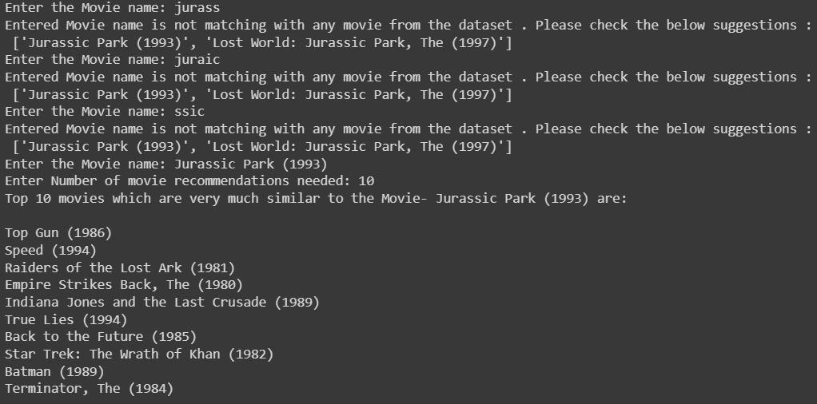
In this input function we can see that if we entered the wrong movie name then it recommended the similar movie name . The significance of this function is that because mostly movie name have year and number so most of the people do not remember about these things so this is the better solution in my opinion.

Slide 17
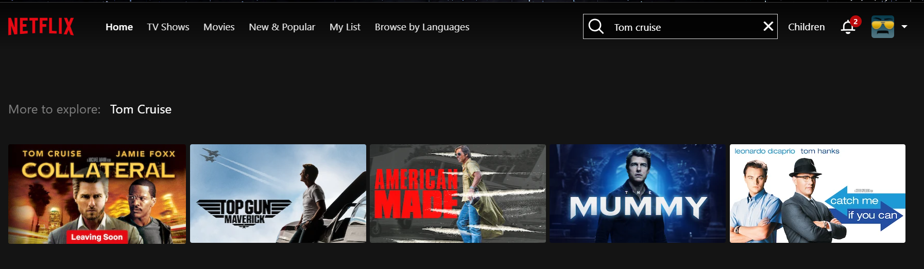


c
Knowledge Based Recommendation
Knowledge-based recommendation system:
Knowledge-based recommendation system is a type of recommendation system that provides personalized recommendations by analyzing the preferences of users and also that particular item fit for the user based on the item database.
Example- In the case of the movie recommendation where a user specifies their preferences for movies based on genres, actors, directors, release year, and ratings.

Slide 18
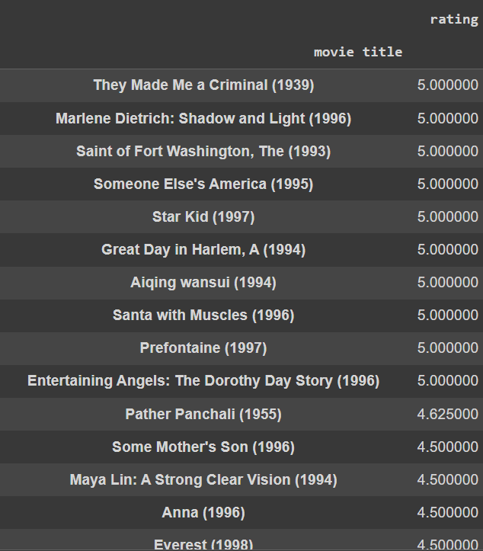
Recommendation based on the average ratings
The drawback of this recommendation is main initially when we seen above there have some movie which have rating 5 star but users have very few so by raitng recommendation is not much correct.

Slide 19
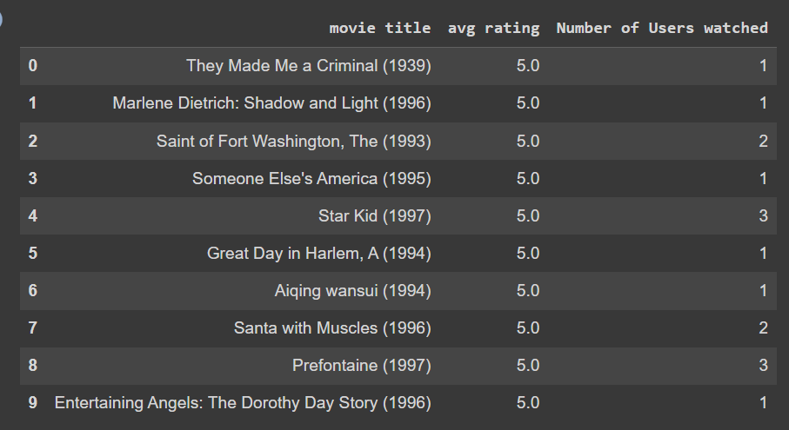
From this output we can seen that most of the avg 5 rating have less number of user who watched the movie

Slide 20
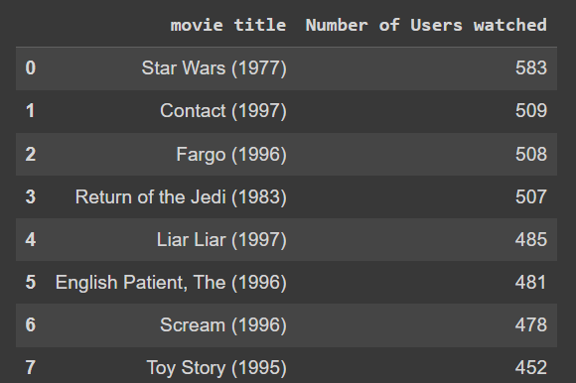
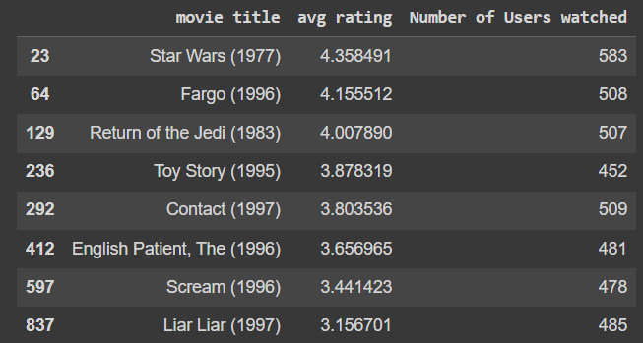
Recommendation to user based on the popularity
For this recommendation we taken the threshold >=450 number of user watched so we got the 8 movies which satisfied this condition
The drawback of this recommendation is that there are many movies in which have large number of the users but avg rating is between in 2 to 3 so it is bad recommendation in my point of view.

Slide 21
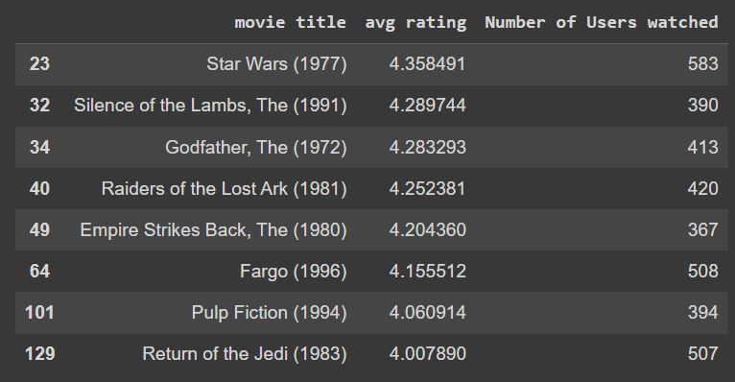
Recommendations based on the popularity and average ratings
in this case we took the threshold in average rating>=4 and in number of users watched >=350 so it is good recommendation in compared to previous case.

Slide 22
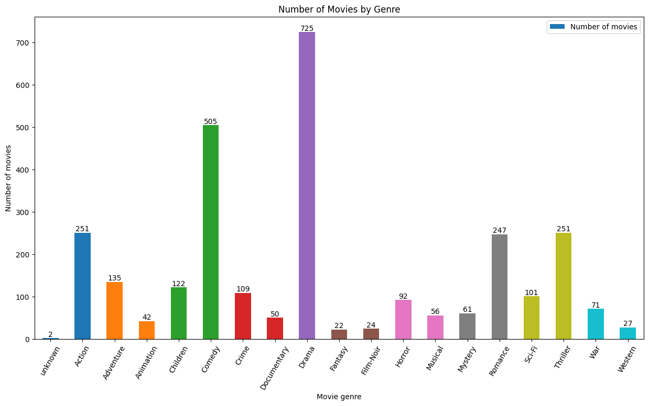
dff
Number of movies vs movie genre
from this graph we can see that most of the movies from the drama genre then comedy and then action and thriller

Slide 23
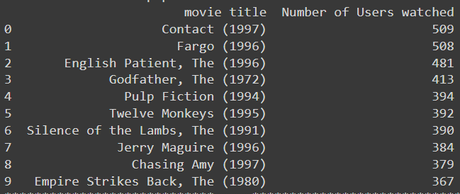
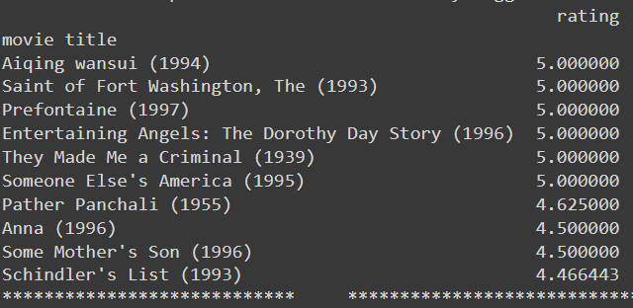
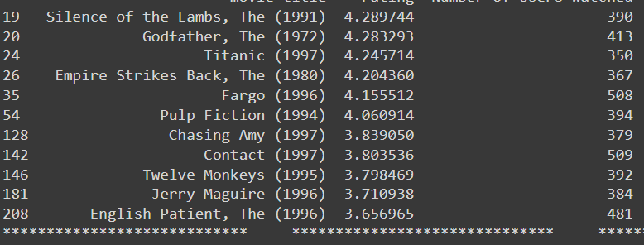
c
Recommendation based on genre
This is the recommendation for the drama genre in which total number of user watched this genre is 39895

Slide 24
Thank you
Email id-kritnandan3@gmail.com

